Slide 1
PIZZA Thirst Satisfied
Presented By
Saritha Durthati
Venkateswaran S
Rishab Ap

Slide 2
INTRODUCTION
A custom pizza online website was created for customers of a pizzeria to create their orders online.

Slide 3
Why An Online System Needed
•This processes is easy to use.
•It will reduce the purchasing time for customers.

Slide 4
OBJECTIVES
•We can build our own pizza.
•Online Payment.
•Reduce paper work

Slide 5
MODULES:
CUSTOMER MODULE
BILL MODULE
Order MODULE

Slide 6
SOFTWARE INTERFACE
FRONT-END TECHNOLOGIES – HTML , CSS, Bootstrap, JAVASCRIPT, React js
BUSINESS LOGIC LAYER – SPRING-boot
DATA BASE – Oracle

Slide 7
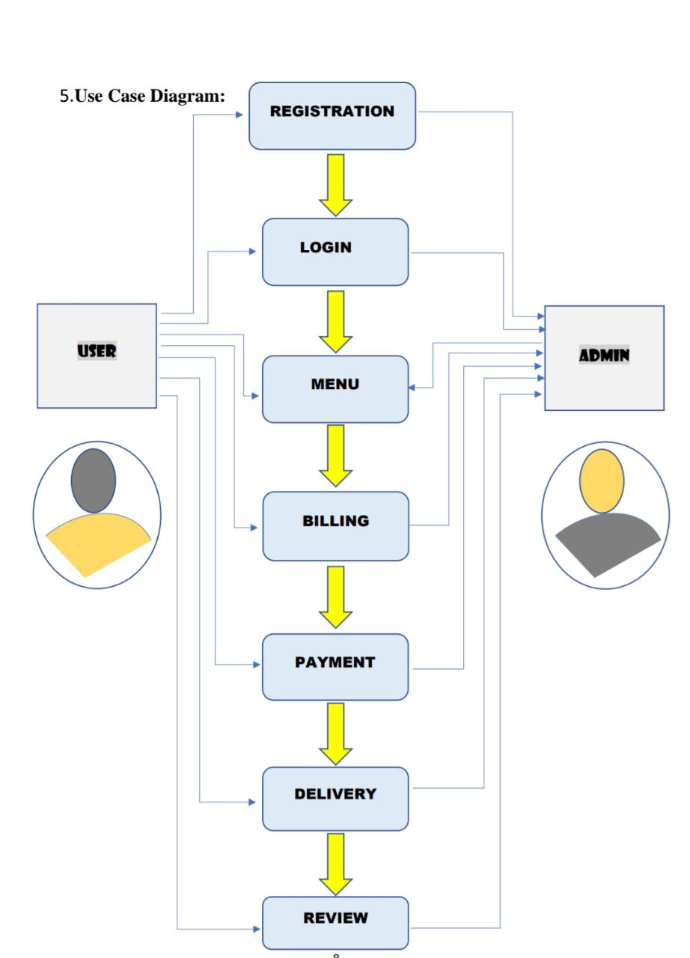
USE CASE MODEL

Slide 8
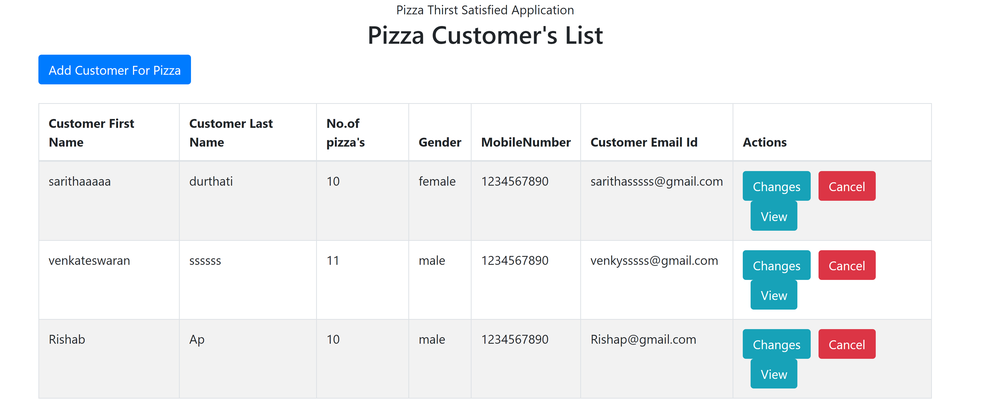
DASHBOARD:

Slide 9
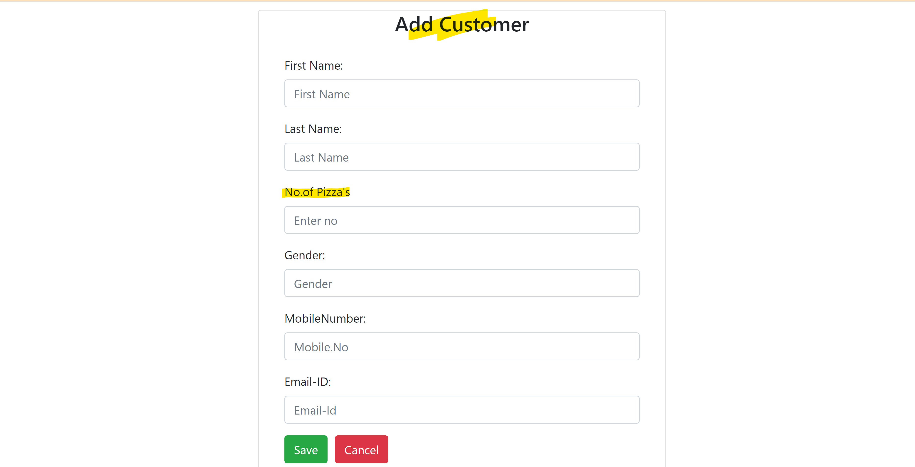
REGISTRATION PAGE

Slide 10
THANK YOU

